Slide 1

DriverPass System Analysis
Max Maysonet-Ramirez
Notes:
[No speaker notes required for this slide.]

Slide 2

System Requirements
FUNCTIONAL
Users will be able to add and delete packages from cart
Users will be able to purchase packages in cart
Users will be schedule packages, tests and lessons
NON-FUNCTIONAL
Administrators will be able to generate reports on sales, and user traffic
Users will be able to create and delete passwords and other profile details
Notes:
The system will catered to the users experience making it easy for them to purchase packages and schedule lessons.
Administrators will be able to pull reports, although this isn’t’ needed, It is a nice capability to have.
Users can create profiles, this can be expanded to future growth to add more profile details such as whether there is a preference to learn manual or automatic vehicles.

Slide 3
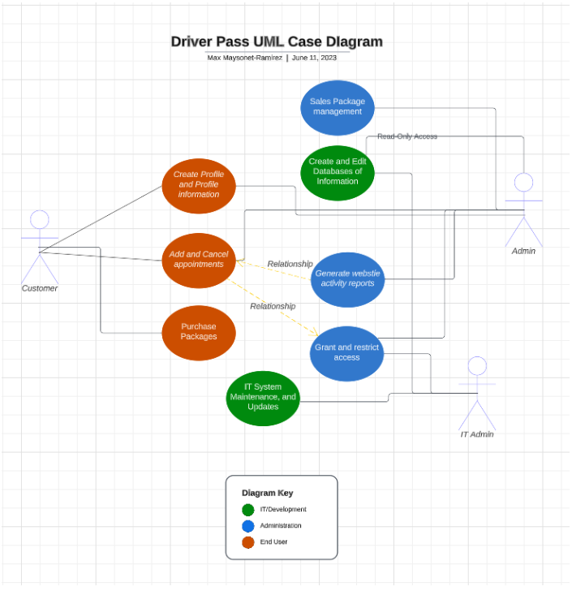
Use Case Diagram
Notes:
The customer will be able to customize profile, add and change packages after purchases and schedule lessons.
Notice the relationship, where the reports will be generated from the appointments that are purchased, added and cancelled, and attended.
Notice the relationship, where the IT Admin can limit and set the schedule for the appointments to be added. Where the user can only schedule lessons in a given window.

Slide 4
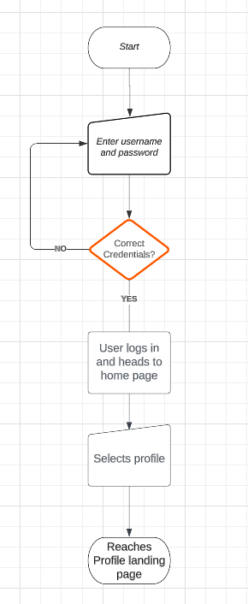
Activity Diagram
Notes:
This is an example of an activity diagram. This visualizes the process of a user reaching the webpage to getting to their profile. This is a very simple form how to reach their profile to get where they can change profile details and parameters.

Slide 5
Security
Users will have to provide password and username to log into profile.
IT administrators can monitor users, restrict users, and monitor traffic
Credentials will be stored in a separate server where the information will stay crypted
DriverPass will be hosted on a client-server infrastructure, where the customers will be limited to what they see.
Through HTTPS protocol, the web application can support secured communications between the servers and client ensuring that any financial information is secured through something called “hashing”
Notes:
Security is the most important of a design. Here we go over the high-level necessities of the Driver Pass program. If need be, we can discuss additional security.
But this Is the bare minimal required to promise operations of the DriverPass product.

Slide 6
System Limitations
System limitations can vary due to budget that is not mentioned
The system right now is limited to pulling reports that aren’t real time. Once the Administrator pulls a report, the system populates the report with the most recent data available. Although, it is not real time data.
Notes:
The reports aren’t real time and don’t have a link the server’s database. The system pulls most recent data from the server and populates it into a comma seperarated value sheet where the last known update is the moment it was printed out.

